Slide 1


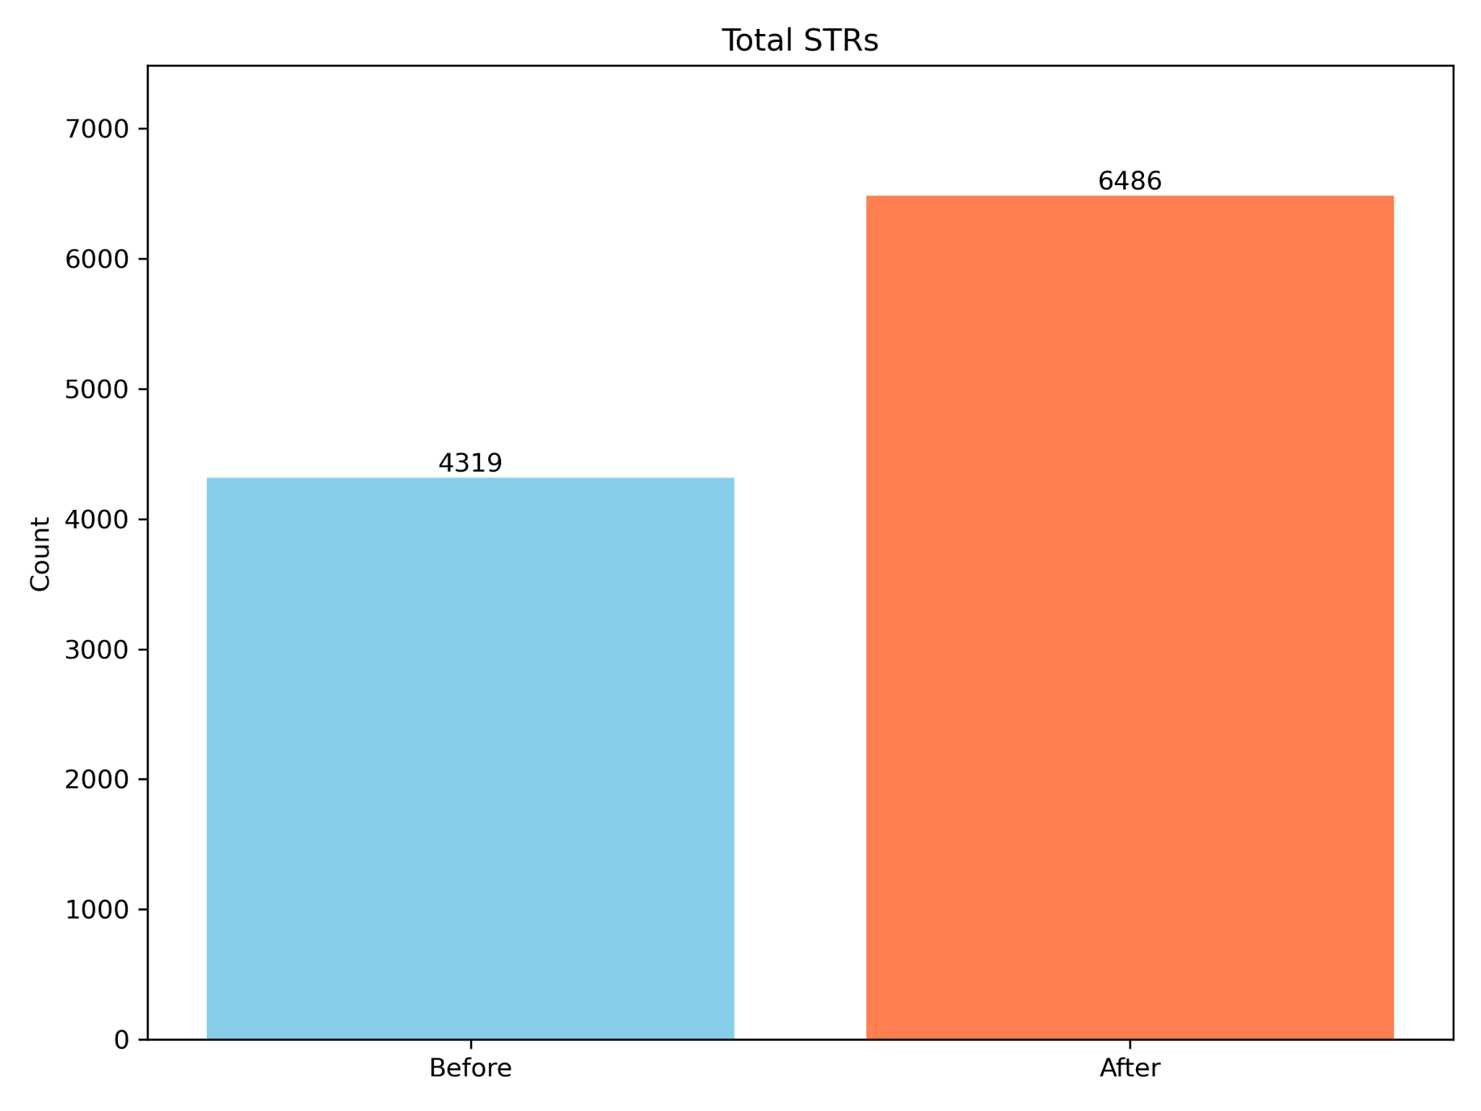
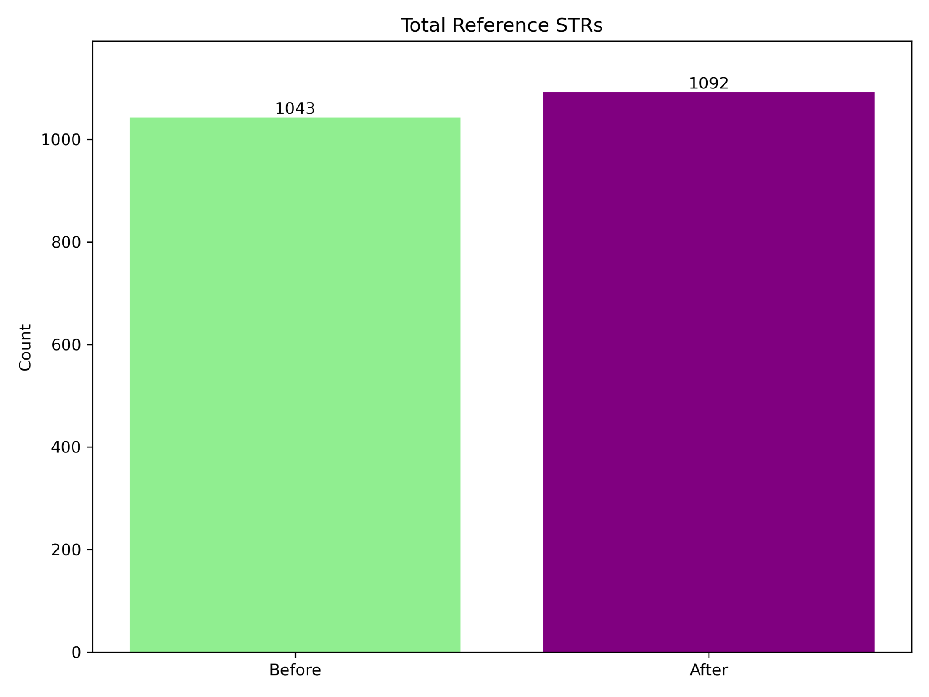
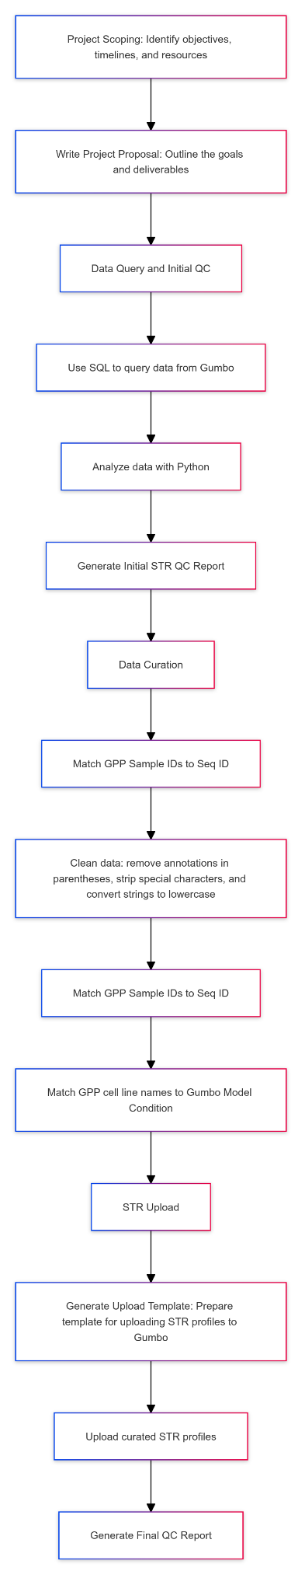
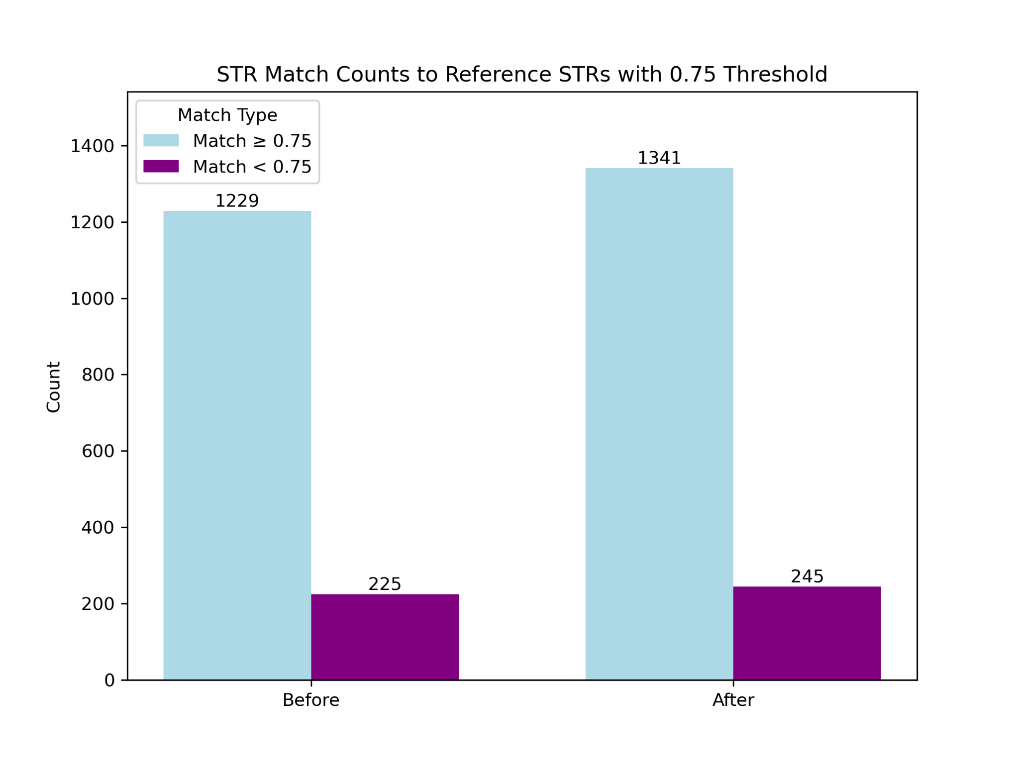
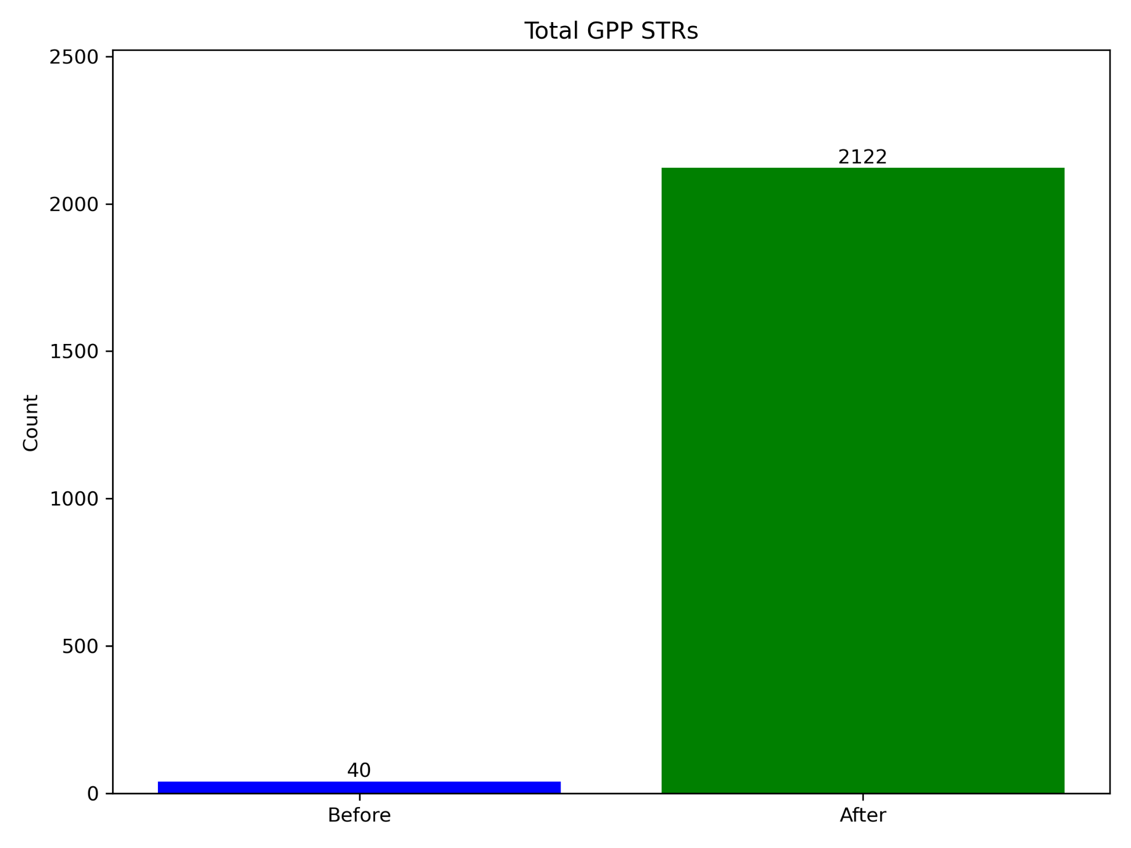

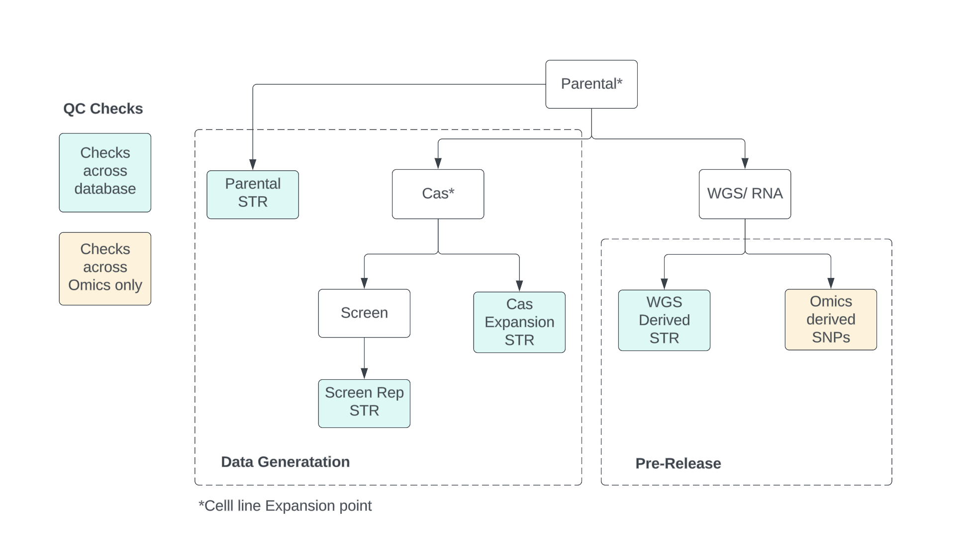
DepMap STR Backlog Data Curation
AUTHOR AUTHOR AUTHOR AUTHOR
Affiliation Affiliation Affiliation
Introduction
DepMap (Cancer Dependency Map) is a project led by the Broad Institute that aims to systematically identify the genetic dependencies and vulnerabilities of cancer cells. DepMap uses multiple data types, such as whole genome sequencing, CRISPR sequencing, and RNA-seq to provide a comprehensive view of cancer cell dependencies to help researchers understand which genes or pathways are essential for the survival, reproduction, and spread of specific types of cancer.
Misidentified or contaminated cell lines can lead to inaccurate experimental results, compromising the integrity of projects. Therefore, researchers use several ways to ensure accurate cell line authentication and identification. One of these ways is STR profiling.
STR profiling serves as a quality control measure, helping researchers validate that their cell lines are authentic and representative of the intended model.
Short Tandem Repeats (STRs) are short sequences of DNA, typically 2-6 base pairs in length, repeated several times in specific locations throughout your genome. These repeats are highly polymorphic – meaning they vary greatly among individuals. This makes them excellent markers for identifying and differentiating individual cell lines.
STR profiling is widely used in biological and pharmaceutical research to authenticate cell lines - ensuring that researchers are working with the correct cells, free from contamination or misidentification.
The goal of this STR backfill project is to ensure the accurate and complete identification of cell lines by addressing gaps, curating, and uploading a backlog of STR profile information on DepMap’s operational database - GUMBO, a database used for tracking experimental progress, and data quality checks. I will generate before and after metrics to track project progress.
METHODS AND RESULTS
Conclusions
Identified 1329 cell lines in GUMBO that are currently missing STR profile data
Cross-checked STR profiles with the existing STR database for cell line verification to ensure fidelity, and identified potential misidentifications.
Integrated the newly generated STR profiles into the Gumbo database.
Reported quality metrics, including:
  Total STRs
  Total reference STRs
  Model Conditions with reference STRs but no sample STRs
  Model Conditions with sample STRs but no reference STRs
  STRs with percentage match to parental
  Mismatched patient ids
  STRs by source
  STRs with missing model condition id
By ensuring that every cell line used in DepMap research has an accurate and complete STR profile, we can maintain a high level of quality control over experimental data.
Future directions:
  QC matching check across all cell lines
  Future directions: standardize / automate GPP str profiling into GUMBO
Body text here is 32 pt. Open Sans Normal, but depending on how much text you have it can be anywhere from 24 pt. to 36 pt. Text size should remain consistent throughout the poster.
Body text here is 32 pt. Open Sans Normal, but depending on how much text you have it can be anywhere from 24 pt. to 36 pt. Text size should remain consistent throughout the poster.
Figure captions can be approximately 6 points smaller than text type

